Slide 1
System Modeling Lecture 13-18

Slide 2
Topics covered
Context Models
Process Models
Interaction Models
Structural Models
Behavioral models
Data models

Slide 3
Systems, Models and System Modeling

Slide 4
System
A system is an organized set of communicating parts
A car, composed of four wheels, a chassis, a body, and an engine, is designed to transport people
A payroll system, composed of a computer, printers, software, and the payroll staff, is designed to issue salary checks for employees of a company
Parts of a system can in turn be considered as simpler systems called subsystems.

Slide 5
Model
A model is a simplification of reality
Modeling means constructing an abstraction of a system that focuses on interesting aspects and ignores irrelevant details
We build models so that we can better understand the system we are developing.
We build models of complex system because we cannot comprehend such a system in its entirety.

Slide 6
System Modeling
System Modelling is the process of developing abstract models of a system each representing a different view or perspective of that system.
You may develop models of both the existing system and the system to be developed.
Models of the existing system are used during requirements engineering.
Help clarify what the existing system does and can be used as a basis for discussing its strengths and weaknesses.
Models of the new system are used during requirements engineering to help explain the proposed requirements to other system stakeholders.

Slide 7
System Perspective
You may develop different models to represent the system from different perspectives
An external perspective, where you model the context or environment of the system.
An interaction perspective where you model the interactions between a system and its environment or between the components of a system.
A structural perspective, where you model the organization of a system or the structure of the data that is processed by the system.
A behavioral perspective, where you model the dynamic behavior of the system and how it responds to events.

Slide 8
Unified Modeling Language
UML is a standard language for modeling software systems
Serves as a bridge between the requirements specification and the implementation.
Provides a means to specify and document the design of a software system.
UML is process and programming language independent.
UML is particularly suited to object-oriented program development.

Slide 9
Types of UML Diagrams
Use case diagrams, which show the interactions between a system and its environment.
Sequence diagrams, which show interactions between actors and the system and between system components.
Activity diagrams, which show the activities involved in a process or in data processing .
Class diagrams, which show the object classes in the system and the associations between these classes.
State diagrams, which show how the system reacts to internal and external events

Slide 10
Use of Graphical Models
Three ways in which graphical models are common
As a means of facilitating discussion about an existing or proposed system.
Incomplete and incorrect models are OK as their role is to support discussion.
As a way of documenting an existing system.
Models should be an accurate representation of the system but need not be complete.
As a detailed system description that can be used to generate a system implementation.
Models have to be both correct and complete.

Slide 11
Process Model

Slide 12
Process Model
Process models reveal how the system being developed is used in broader business processes.
Process models show the overall process and the processes that are supported by the system.
UML activity diagrams may be used to define business process models.

Slide 13
Activity Diagram
An activity diagram visually presents a series of actions or flow of control in a system similar to a flowchart or a data flow diagram.
Activity diagrams are often used in business process modeling. They can also describe the steps in a use case diagram.
Activities modeled can be sequential and concurrent. In both cases an activity diagram will have a beginning (an initial state) and an end (a final state).

Slide 14
Where to use Activity Diagrams
Modeling work flow by using activities.
Modeling business requirements.
Investigate business requirements at a later stage.
High level understanding of the system's functionalities.

Slide 15
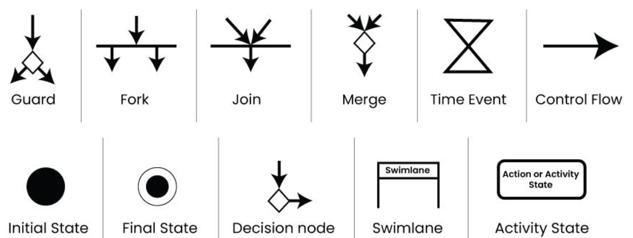
Activity Diagram Notations

Slide 16

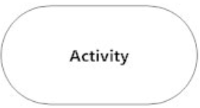
Activity Diagram Notations
Initial State or Start Point
A small filled circle followed by an arrow represents the initial action state or the start point for any activity diagram. For activity diagram using swimlanes, make sure the start point is placed in the top left corner of the first column.
Activity or Action State
An action state represents the non-interruptible action of objects. You can draw an action state in SmartDraw using a rectangle with rounded corners

Slide 17
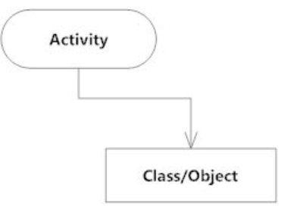
Activity Diagram Notations
Action Flow
Action flows, also called edges and paths, illustrate the transitions from one action state to another. They are usually drawn with an arrowed line.
Object Flow
Object flow refers to the creation and modification of objects by activities.
An object flow arrow from an action to an object means that the action creates or influences the object.
An object flow arrow from an object to an action indicates that the action state uses the object

Slide 18

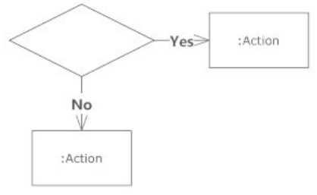
Activity Diagram Notations
Decisions and Branching
A diamond represents a decision with alternate paths. When an activity requires a decision prior to moving on to the next activity, add a diamond between the two activities. The outgoing alternates should be labeled with a condition or guard expression. You can also label one of the paths "else.“
Guards
In UML, guards are a statement written next to a decision diamond that must be true before moving next to the next activity. These are not essential, but are useful when a specific answer, such as "Yes, three labels are printed," is needed before moving forward.

Slide 19
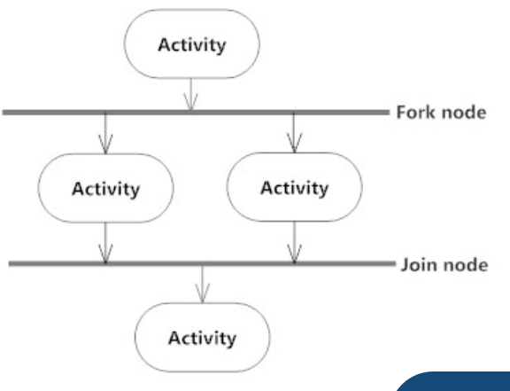
Activity Diagram Notations
Synchronization
A fork node is used to split a single incoming flow into multiple concurrent flows. It is represented as a straight, slightly thicker line in an activity diagram.
A join node joins multiple concurrent flows back into a single outgoing flow.
A fork and join mode used together are often referred to as synchronization.

Slide 20
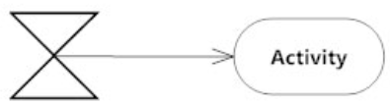
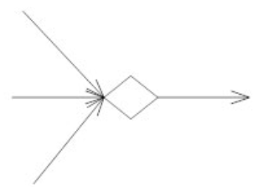
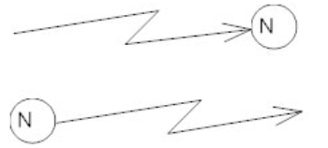
Activity Diagram Notations
Time Event
This refers to an event that stops the flow for a time; an hourglass depicts
Merge Event
A merge event brings together multiple flows that are not concurrent.
Interrupting Edge
An event, such as a cancellation, that interrupts the flow denoted with a lightning bolt.

Slide 21
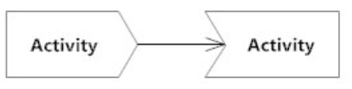

Activity Diagram Notations
Sent and Received Signals
Signals represent how activities can be modified from outside the system. They usually appear in pairs of sent and received signals, because the state can't change until a response is received, much like synchronous messages in a sequence diagram. For example, an authorization of payment is needed before an order can be completed.
Final State or End Point
An arrow pointing to a filled circle nested inside another circle represents the final action state

Slide 22
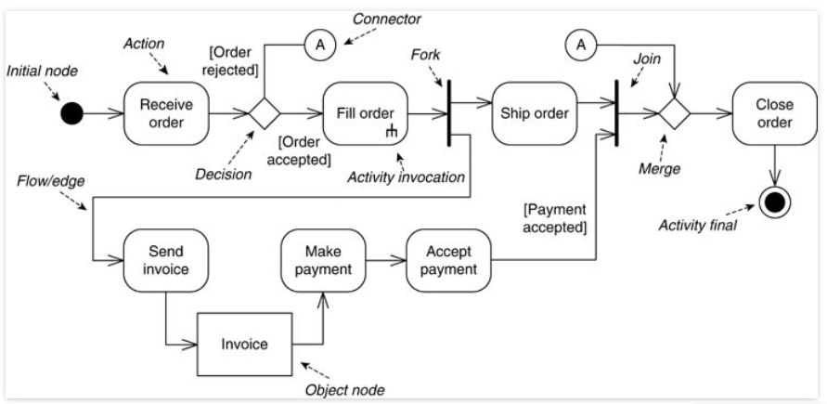
Understanding activity diagram symbols

Slide 23
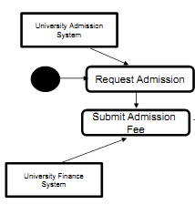
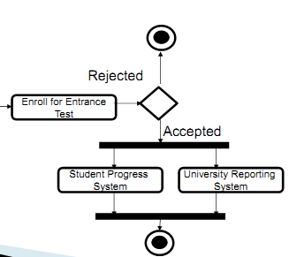
University Admission System

Slide 24
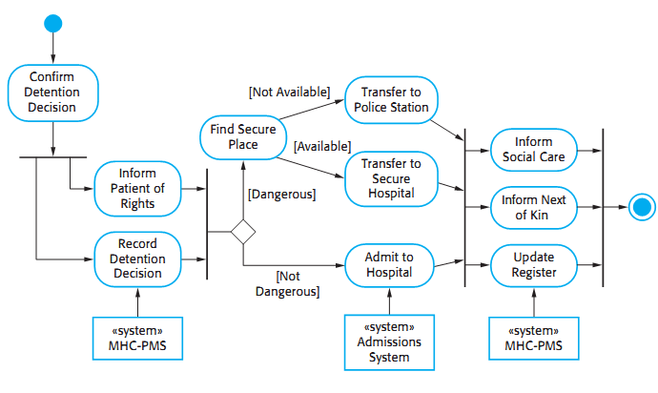
Process model of involuntary detention

Slide 25
Example
Decision in the Open Incident process. If the Incident is a fire and is of high priority, the Dispatcher notifies the FireChief. If it is a high-priority Incident that is not a fire, the PoliceChief is notified. In all cases, the Dispatcher allocates resources to deal with the Incident.

Slide 26
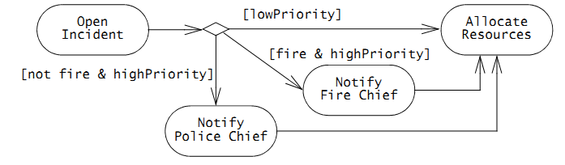
Solution

Slide 27
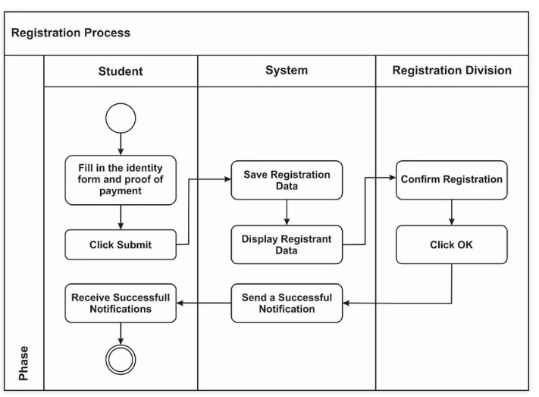
Activity diagram examples for streamlining processes

Slide 28
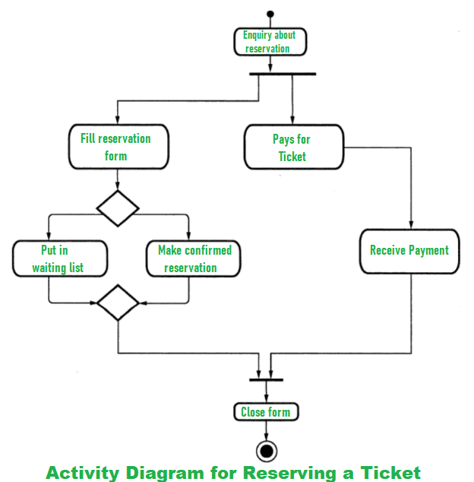

Slide 29
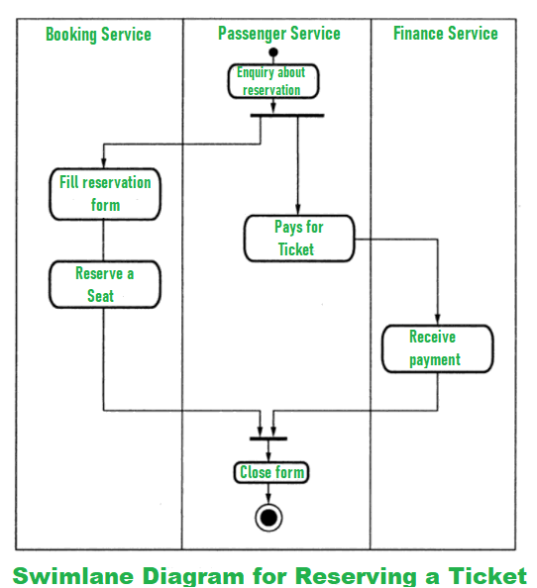

Slide 30
References
https://www.uml-diagrams.org/document-management-uml-activity-diagram-example.html
https://venngage.com/blog/activity-diagram/
https://www.geeksforgeeks.org/unified-modeling-language-uml-activity-diagrams/
https://www.visual-paradigm.com/guide/uml-unified-modeling-language/what-is-activity-diagram/
https://www.smartdraw.com/activity-diagram/#:~:text=Learn%20More-,What%20is%20an%20Activity%20Diagram%3F,in%20a%20use%20case%20diagram.

